Slide 1
Services for people with print disabilities
[Public library name] offers a collection of more than 500,000 books and more for people who have trouble reading print due to a learning, physical or visual disability.

Slide 2
Accessible books and more
Accessible books, magazines, and newspapers
Choose your preferred format: audio, accessible e-text or braille
Full range of subjects, genres, best sellers and award winners for all ages

Slide 3
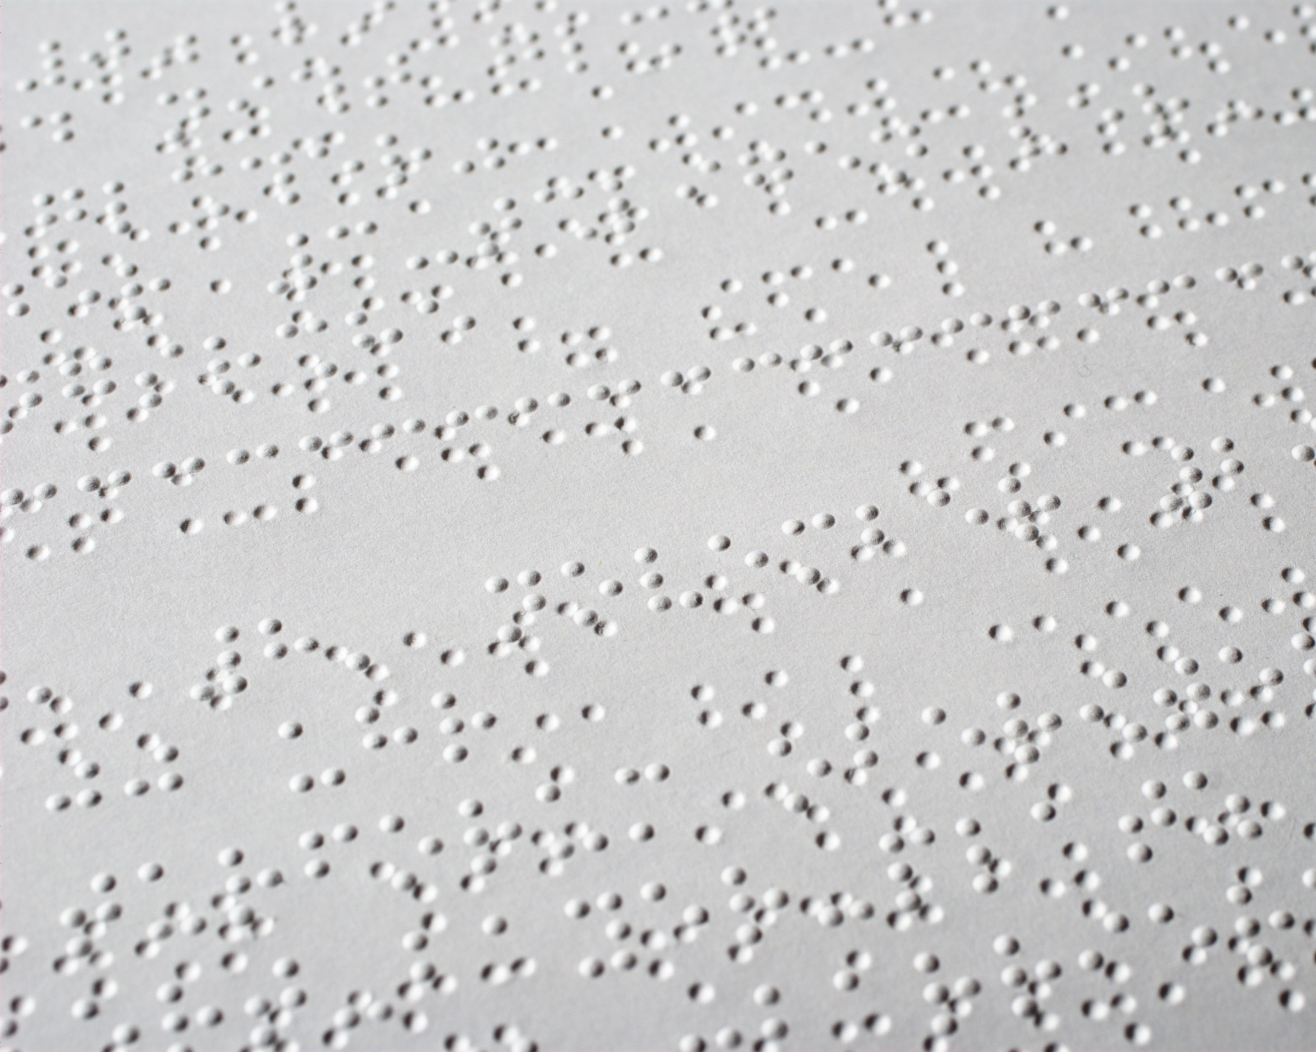
How to read
Download books to your mobile device and read with an accessible reading app like Dolphin EasyReader
Download books to a DAISY player over a wireless connection
Receive audio CDs or braille by mail

Slide 4
Signing up for CELA
Visit celalibrary.ca or contact the library for assistance.
What you need:
Public library card
You must have a print disability to use CELA services, but proof of disability is not required.

